Slide 1
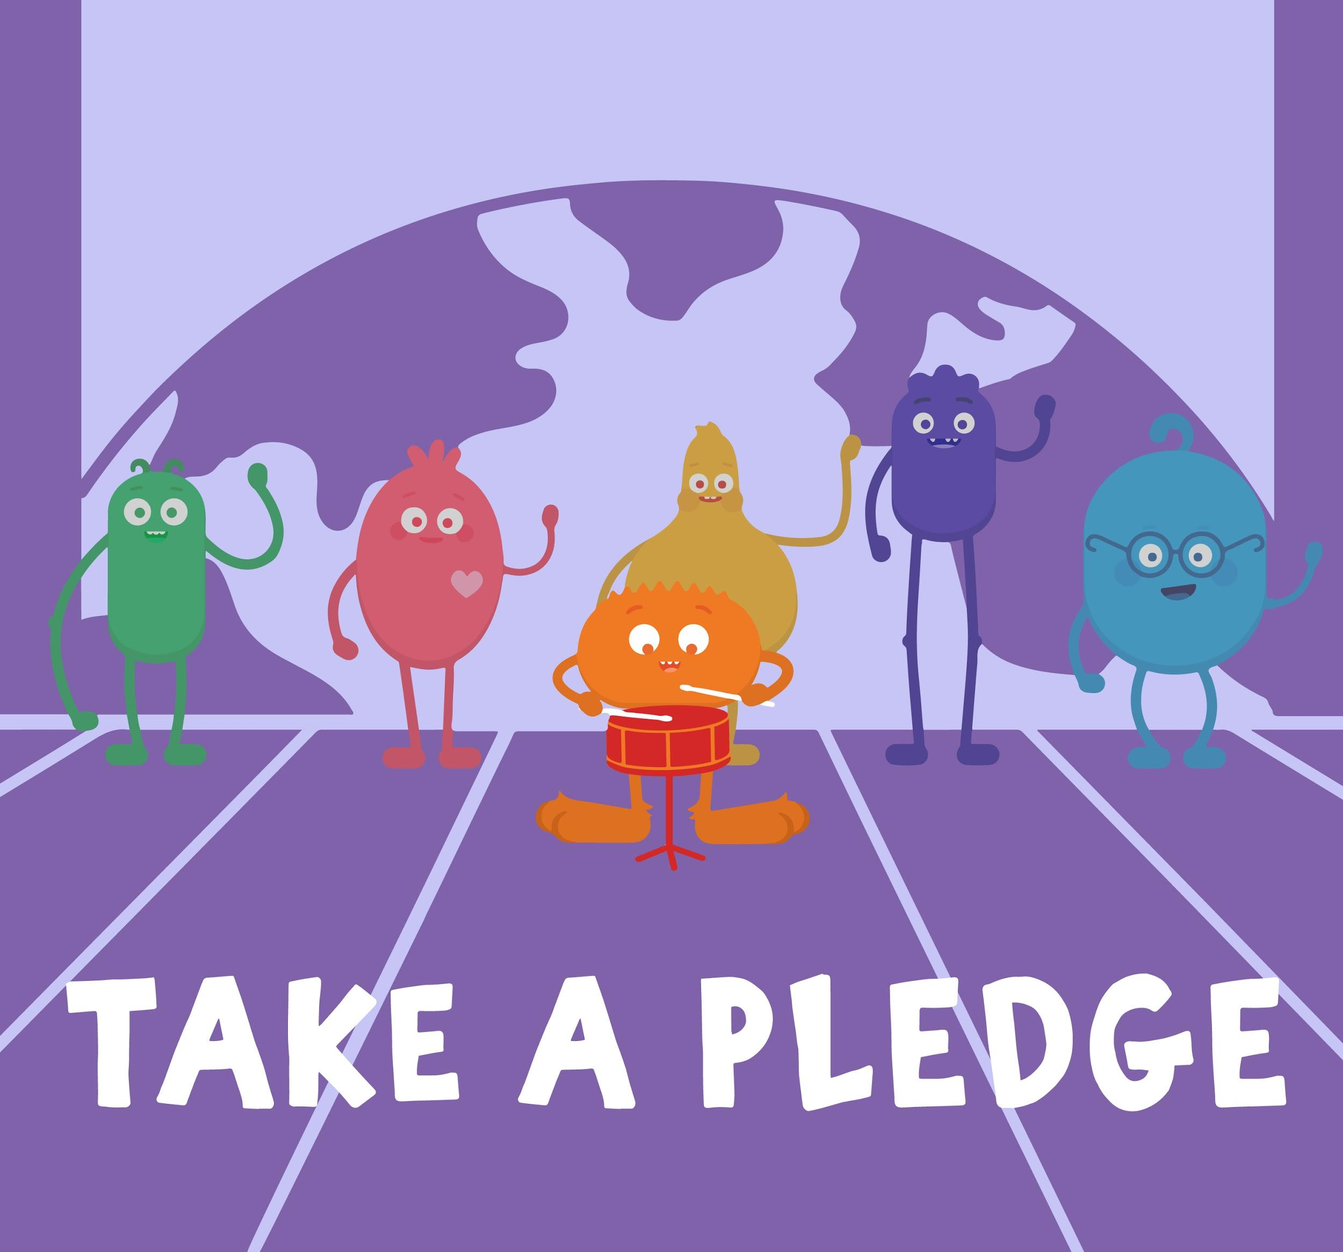
INTRODUCTORY SONG
DIGITAL CITIZENSHIP | GRADE 2
We the Digital Citizens

Slide 2
KEY VOCABULARY
Digital Citizen
Someone who uses technology safely and responsibly
As a digital citizen, there are things we need to do to act and behave responsibly when using the internet.

Slide 3
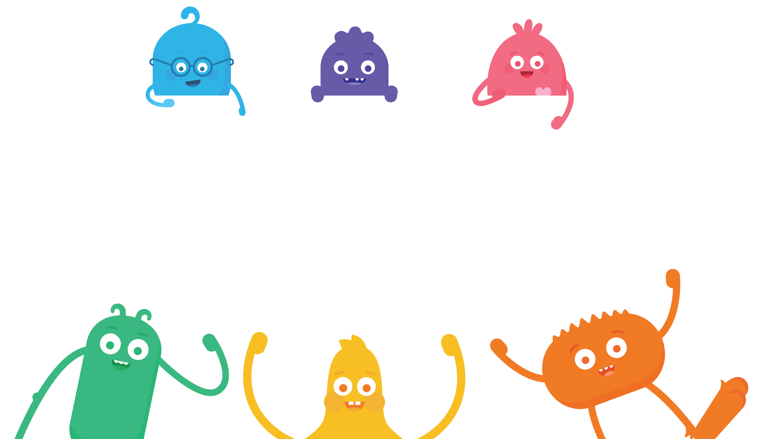
How can we be good digital citizens?

Slide 4
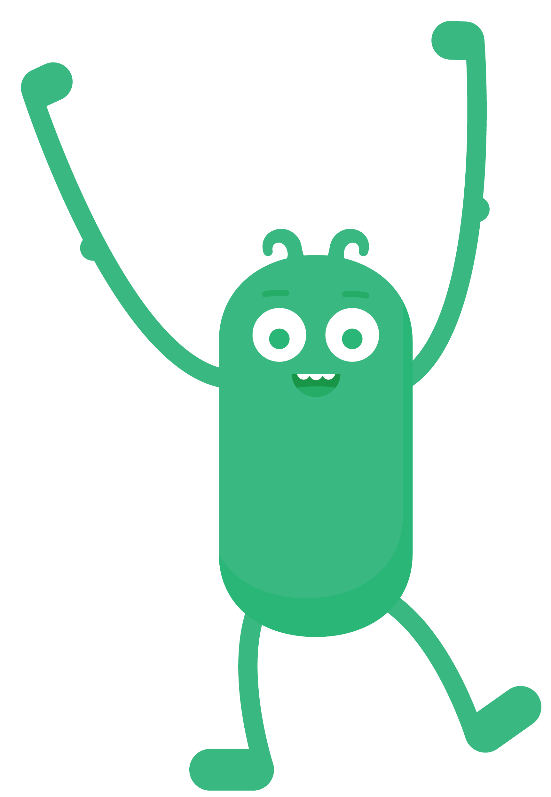
REFLECT
Have you ever made a promise to your family to be safe and responsible? What was your promise?

Slide 5
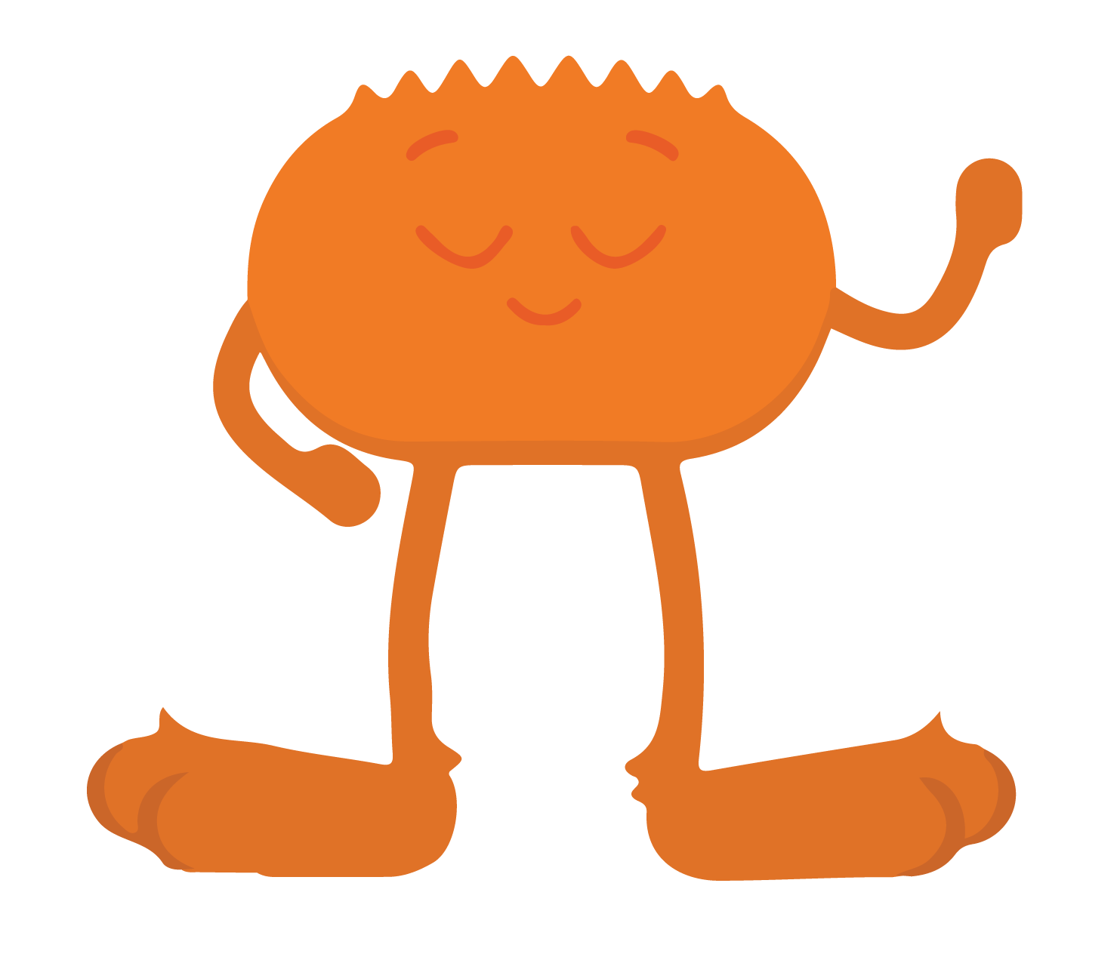
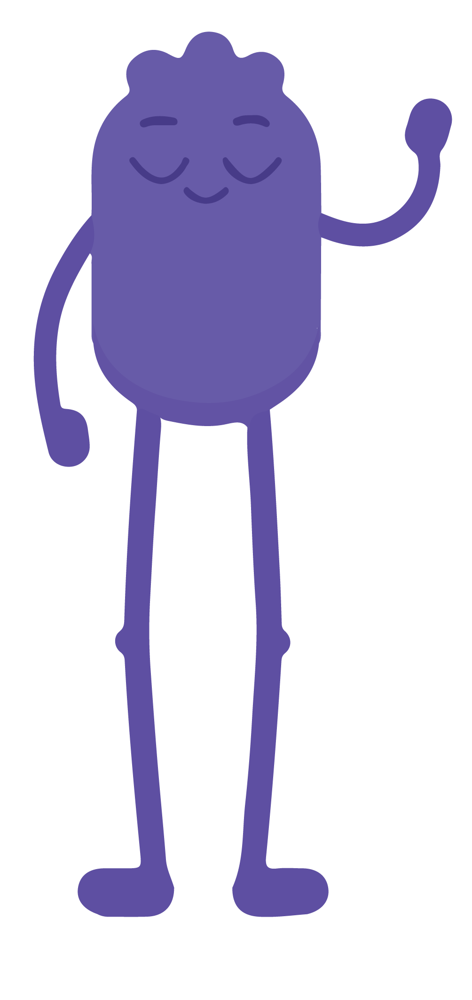
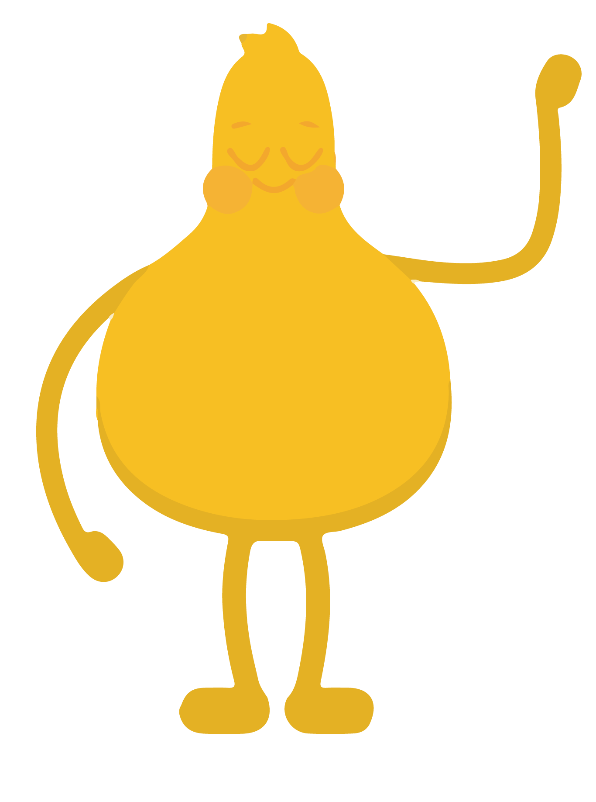
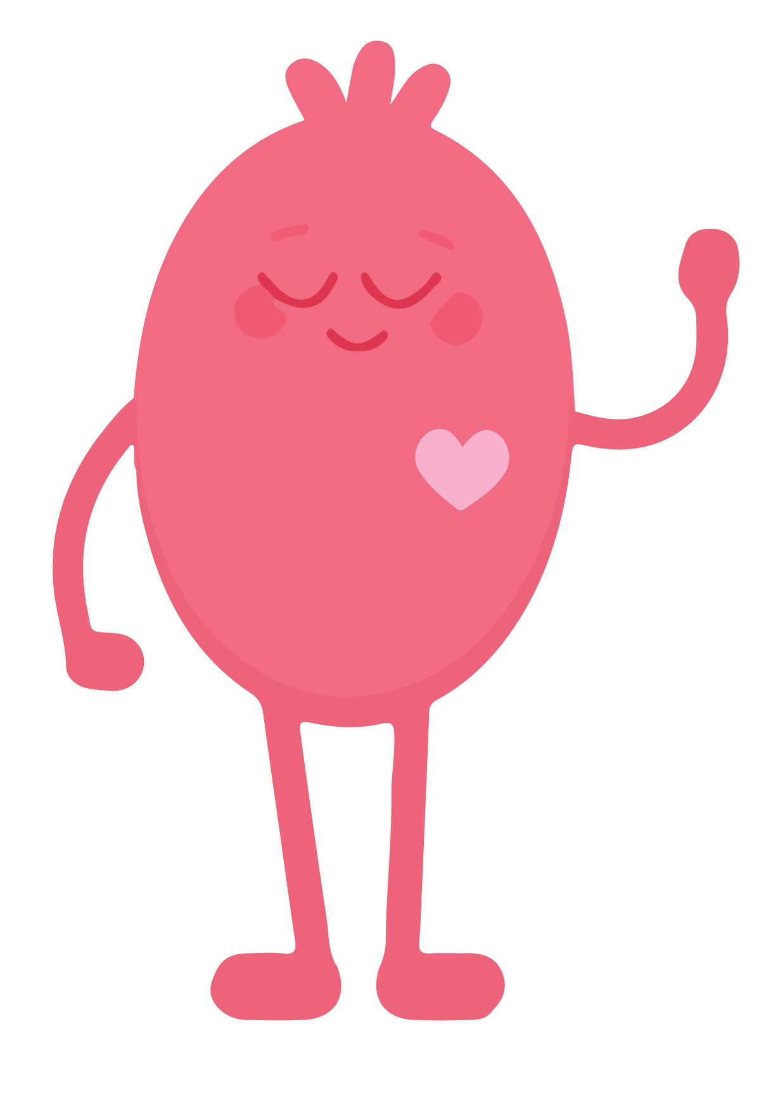
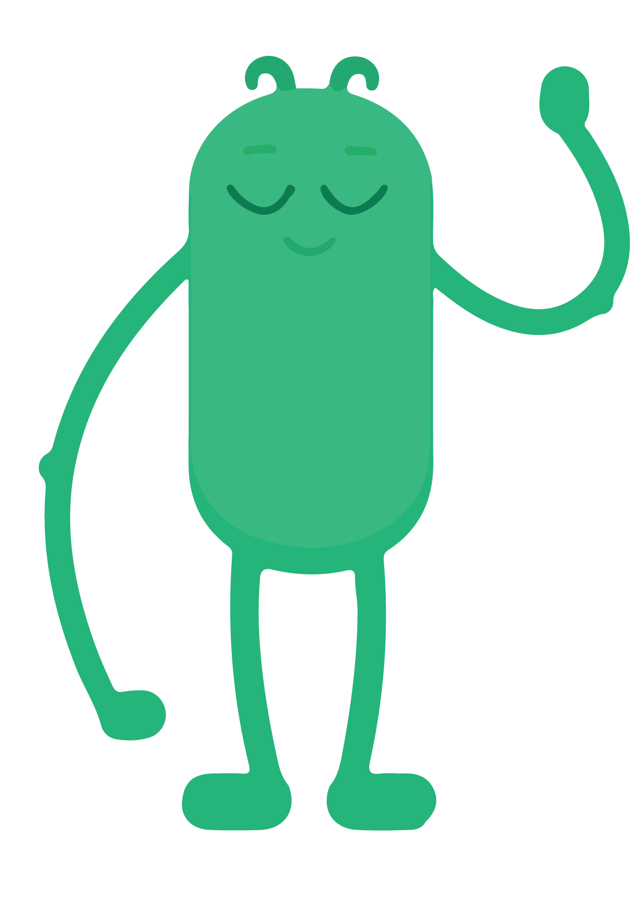
KEY VOCABULARY
Pledge
A promise that one makes
Today we are going to begin thinking about taking a pledge to be a good digital citizen

Slide 6
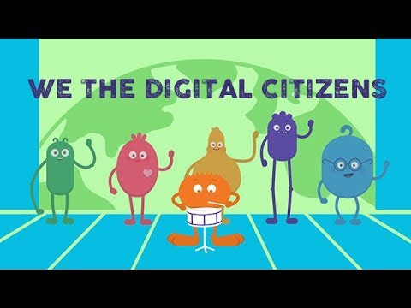
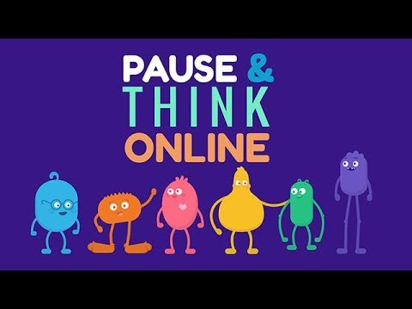
WATCH
To watch this video on the Common Sense Education site, click here.

Slide 7
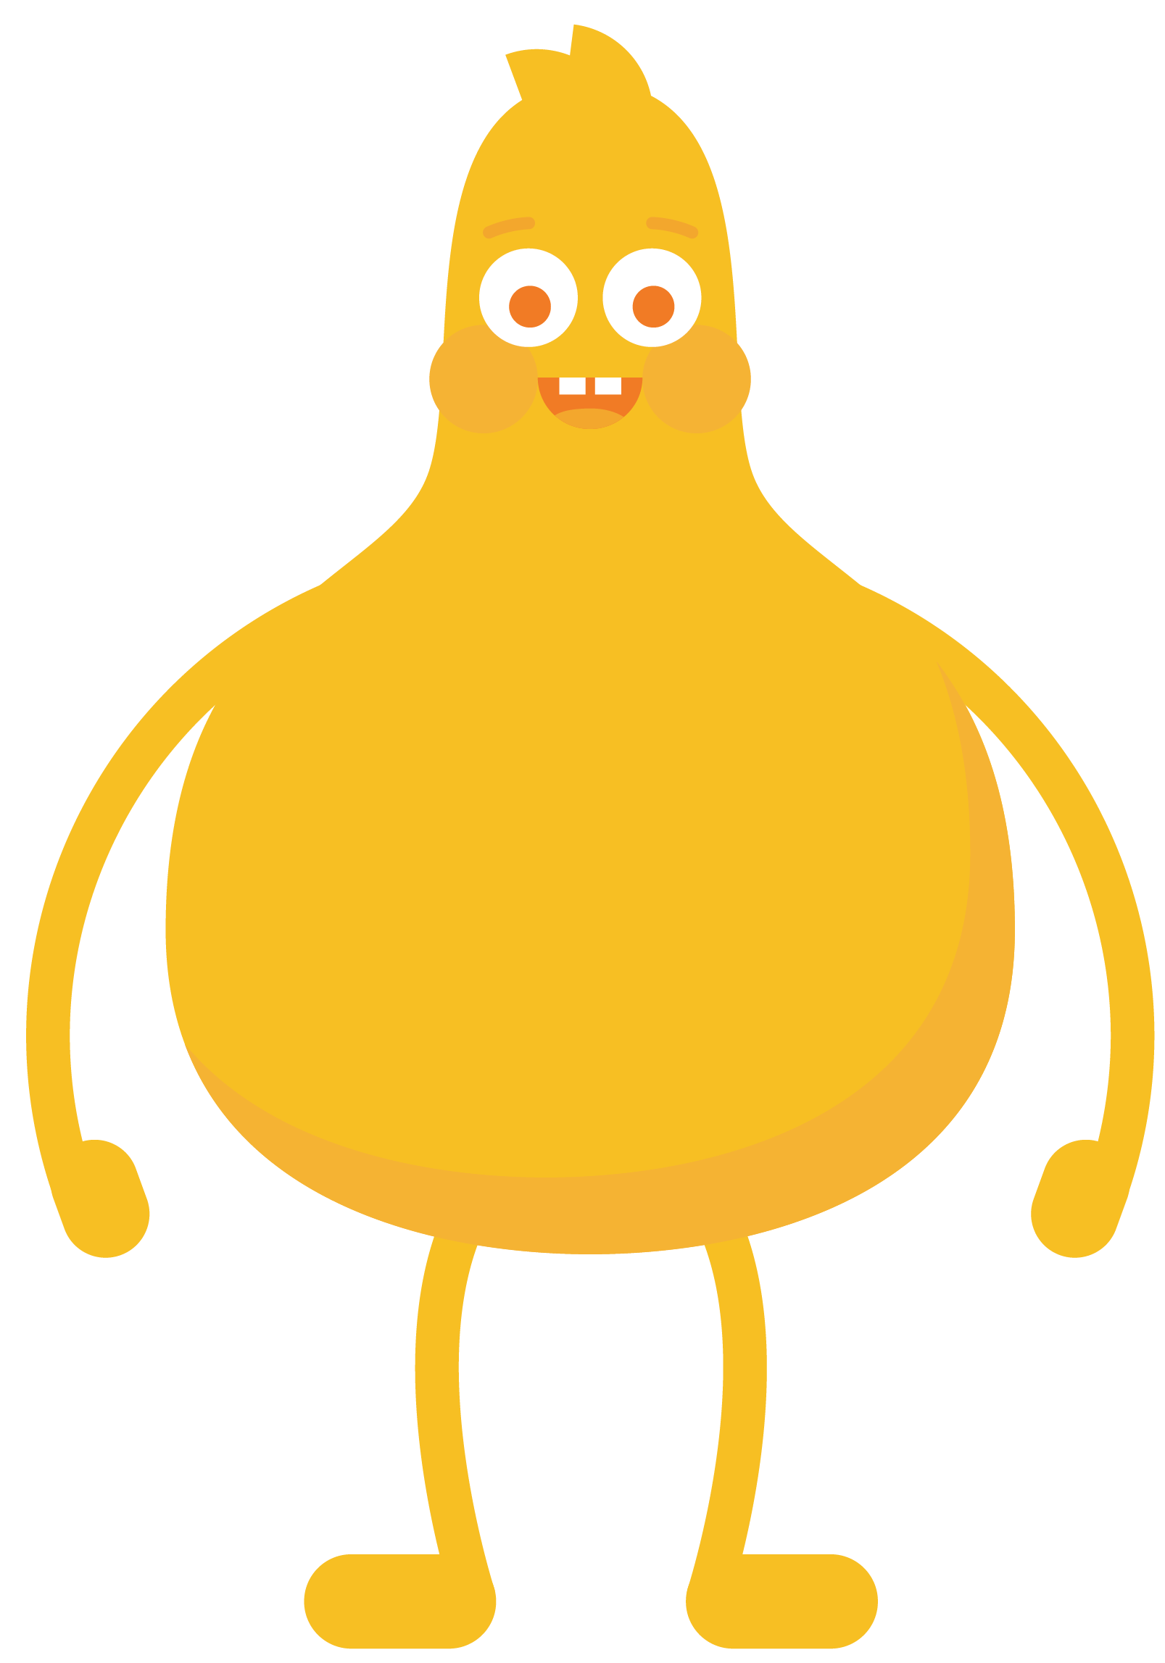
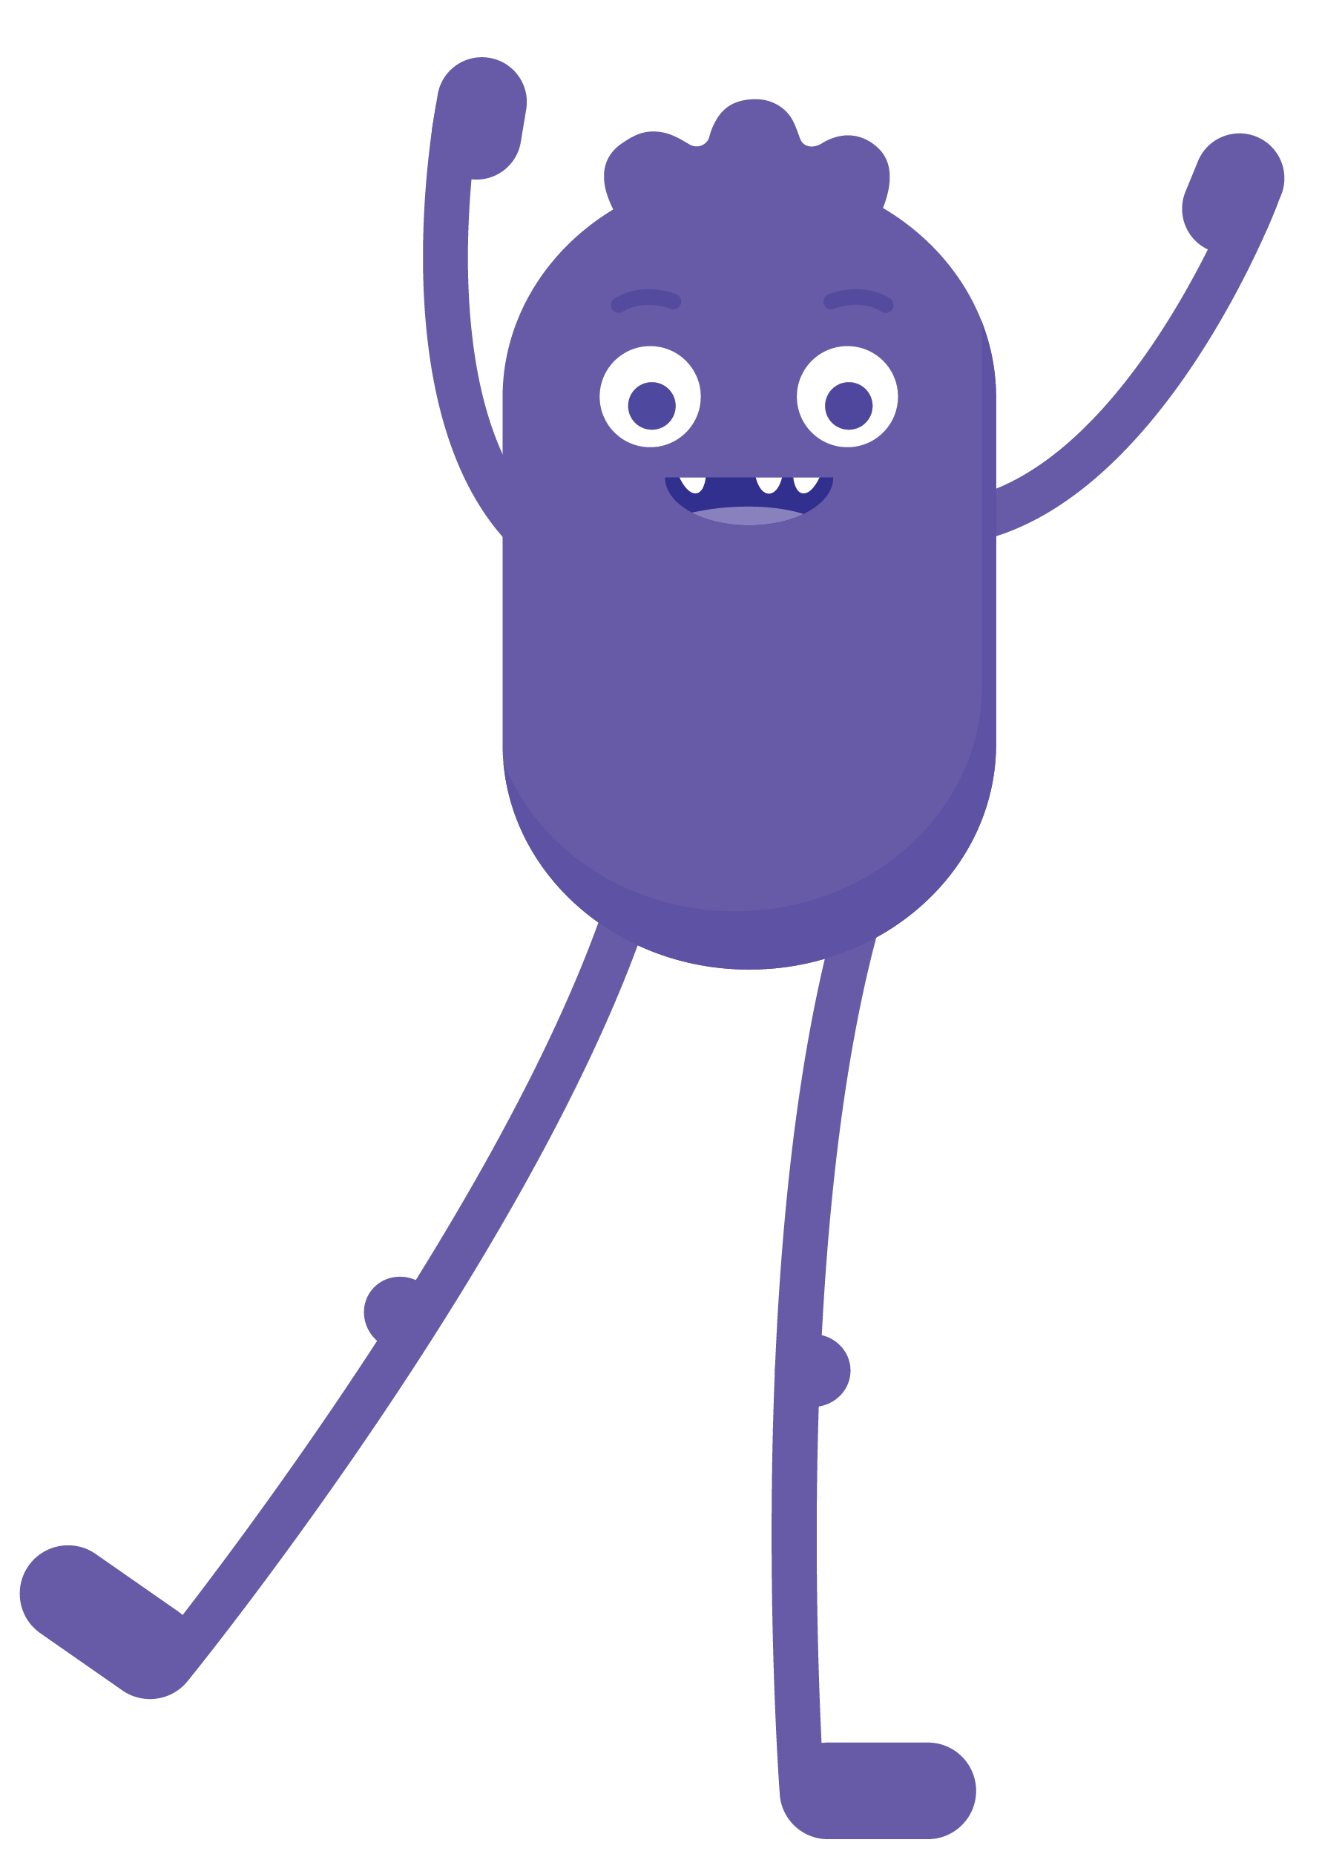
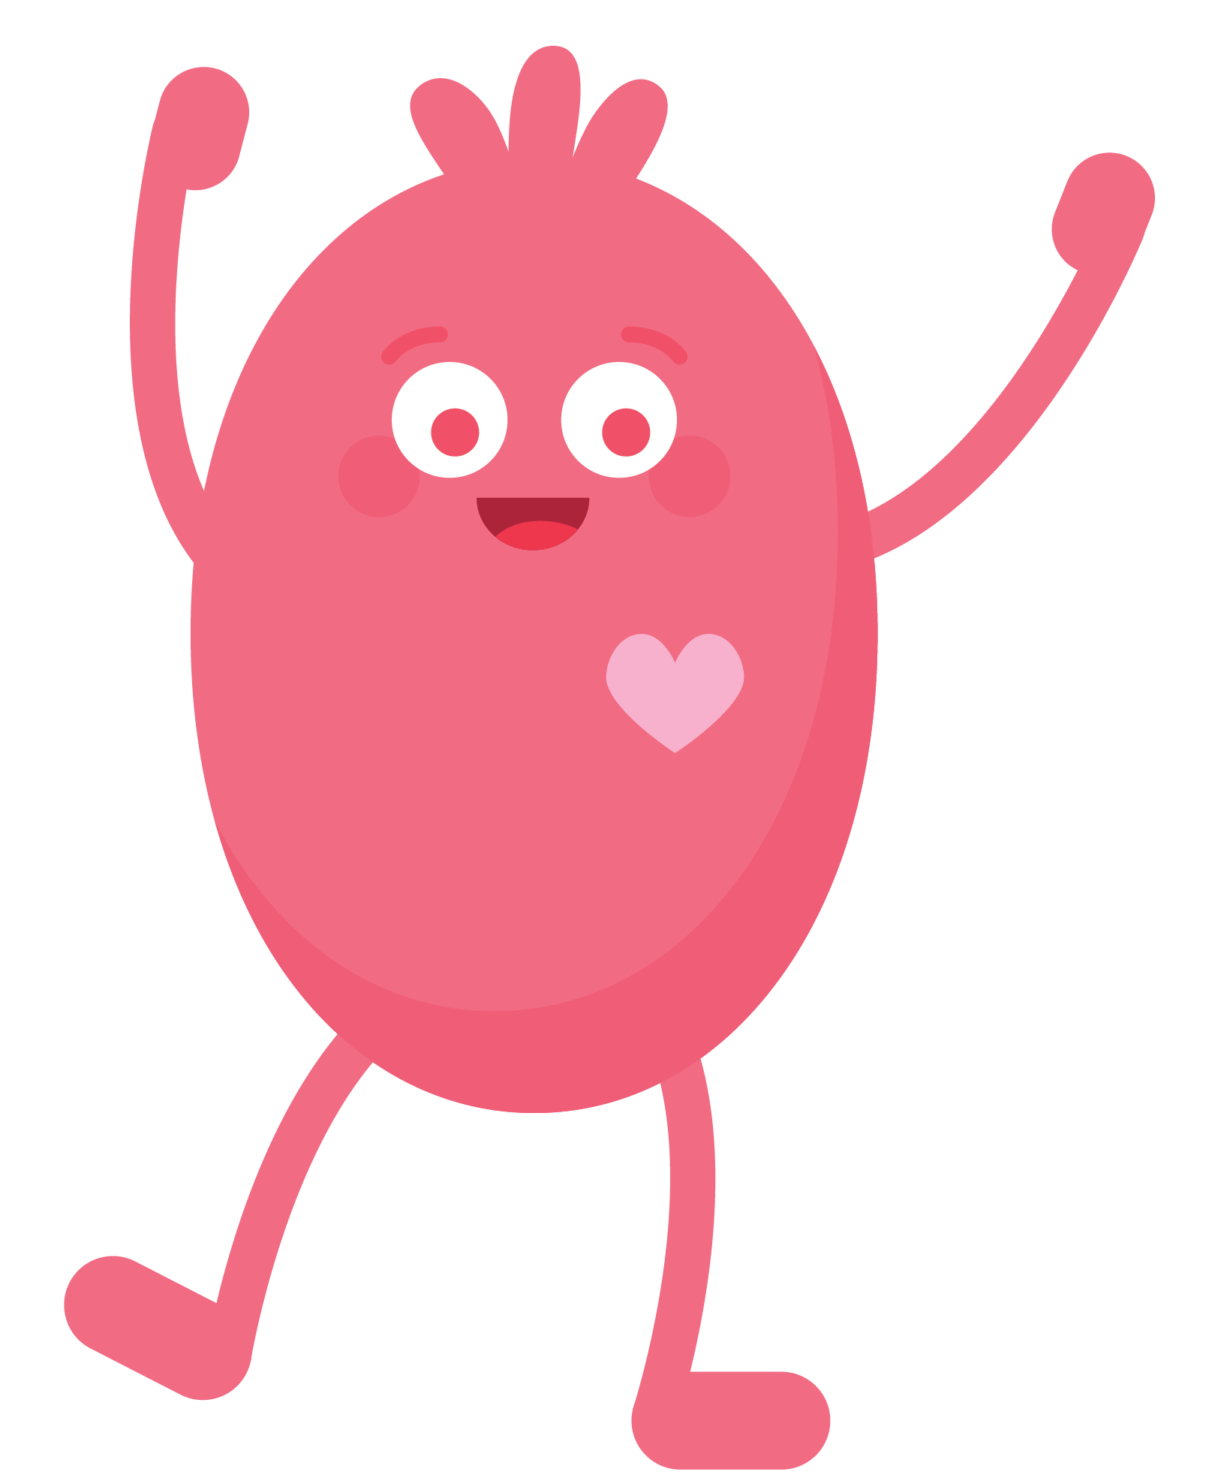
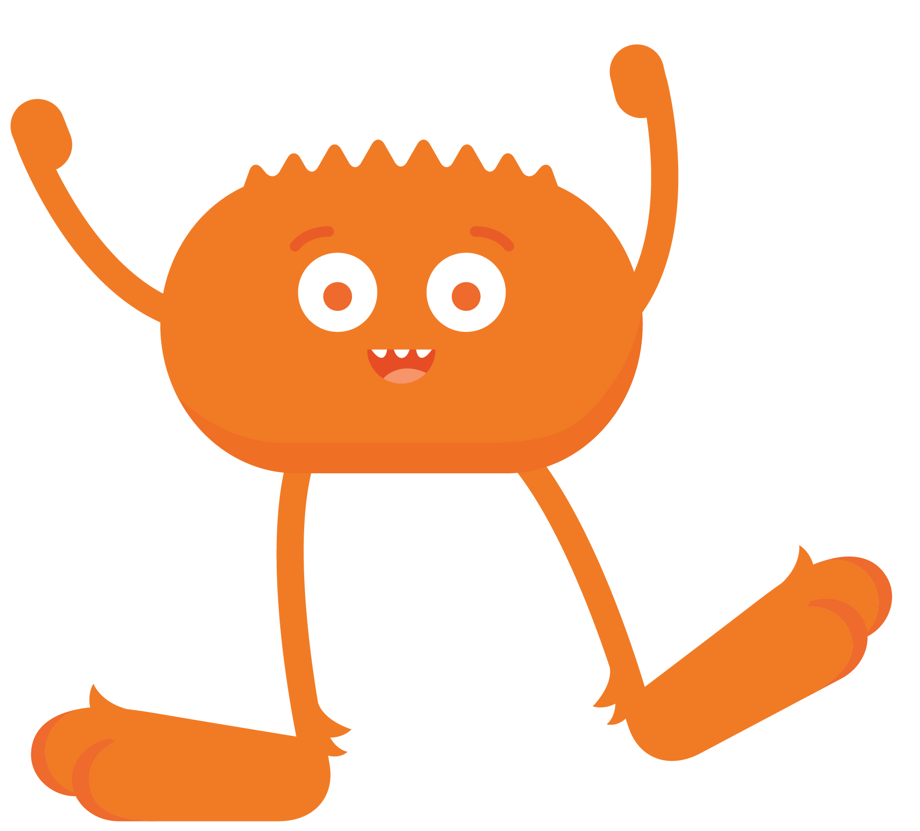
REFLECT
What was one thing you learned from the Digital Citizens?

Slide 8
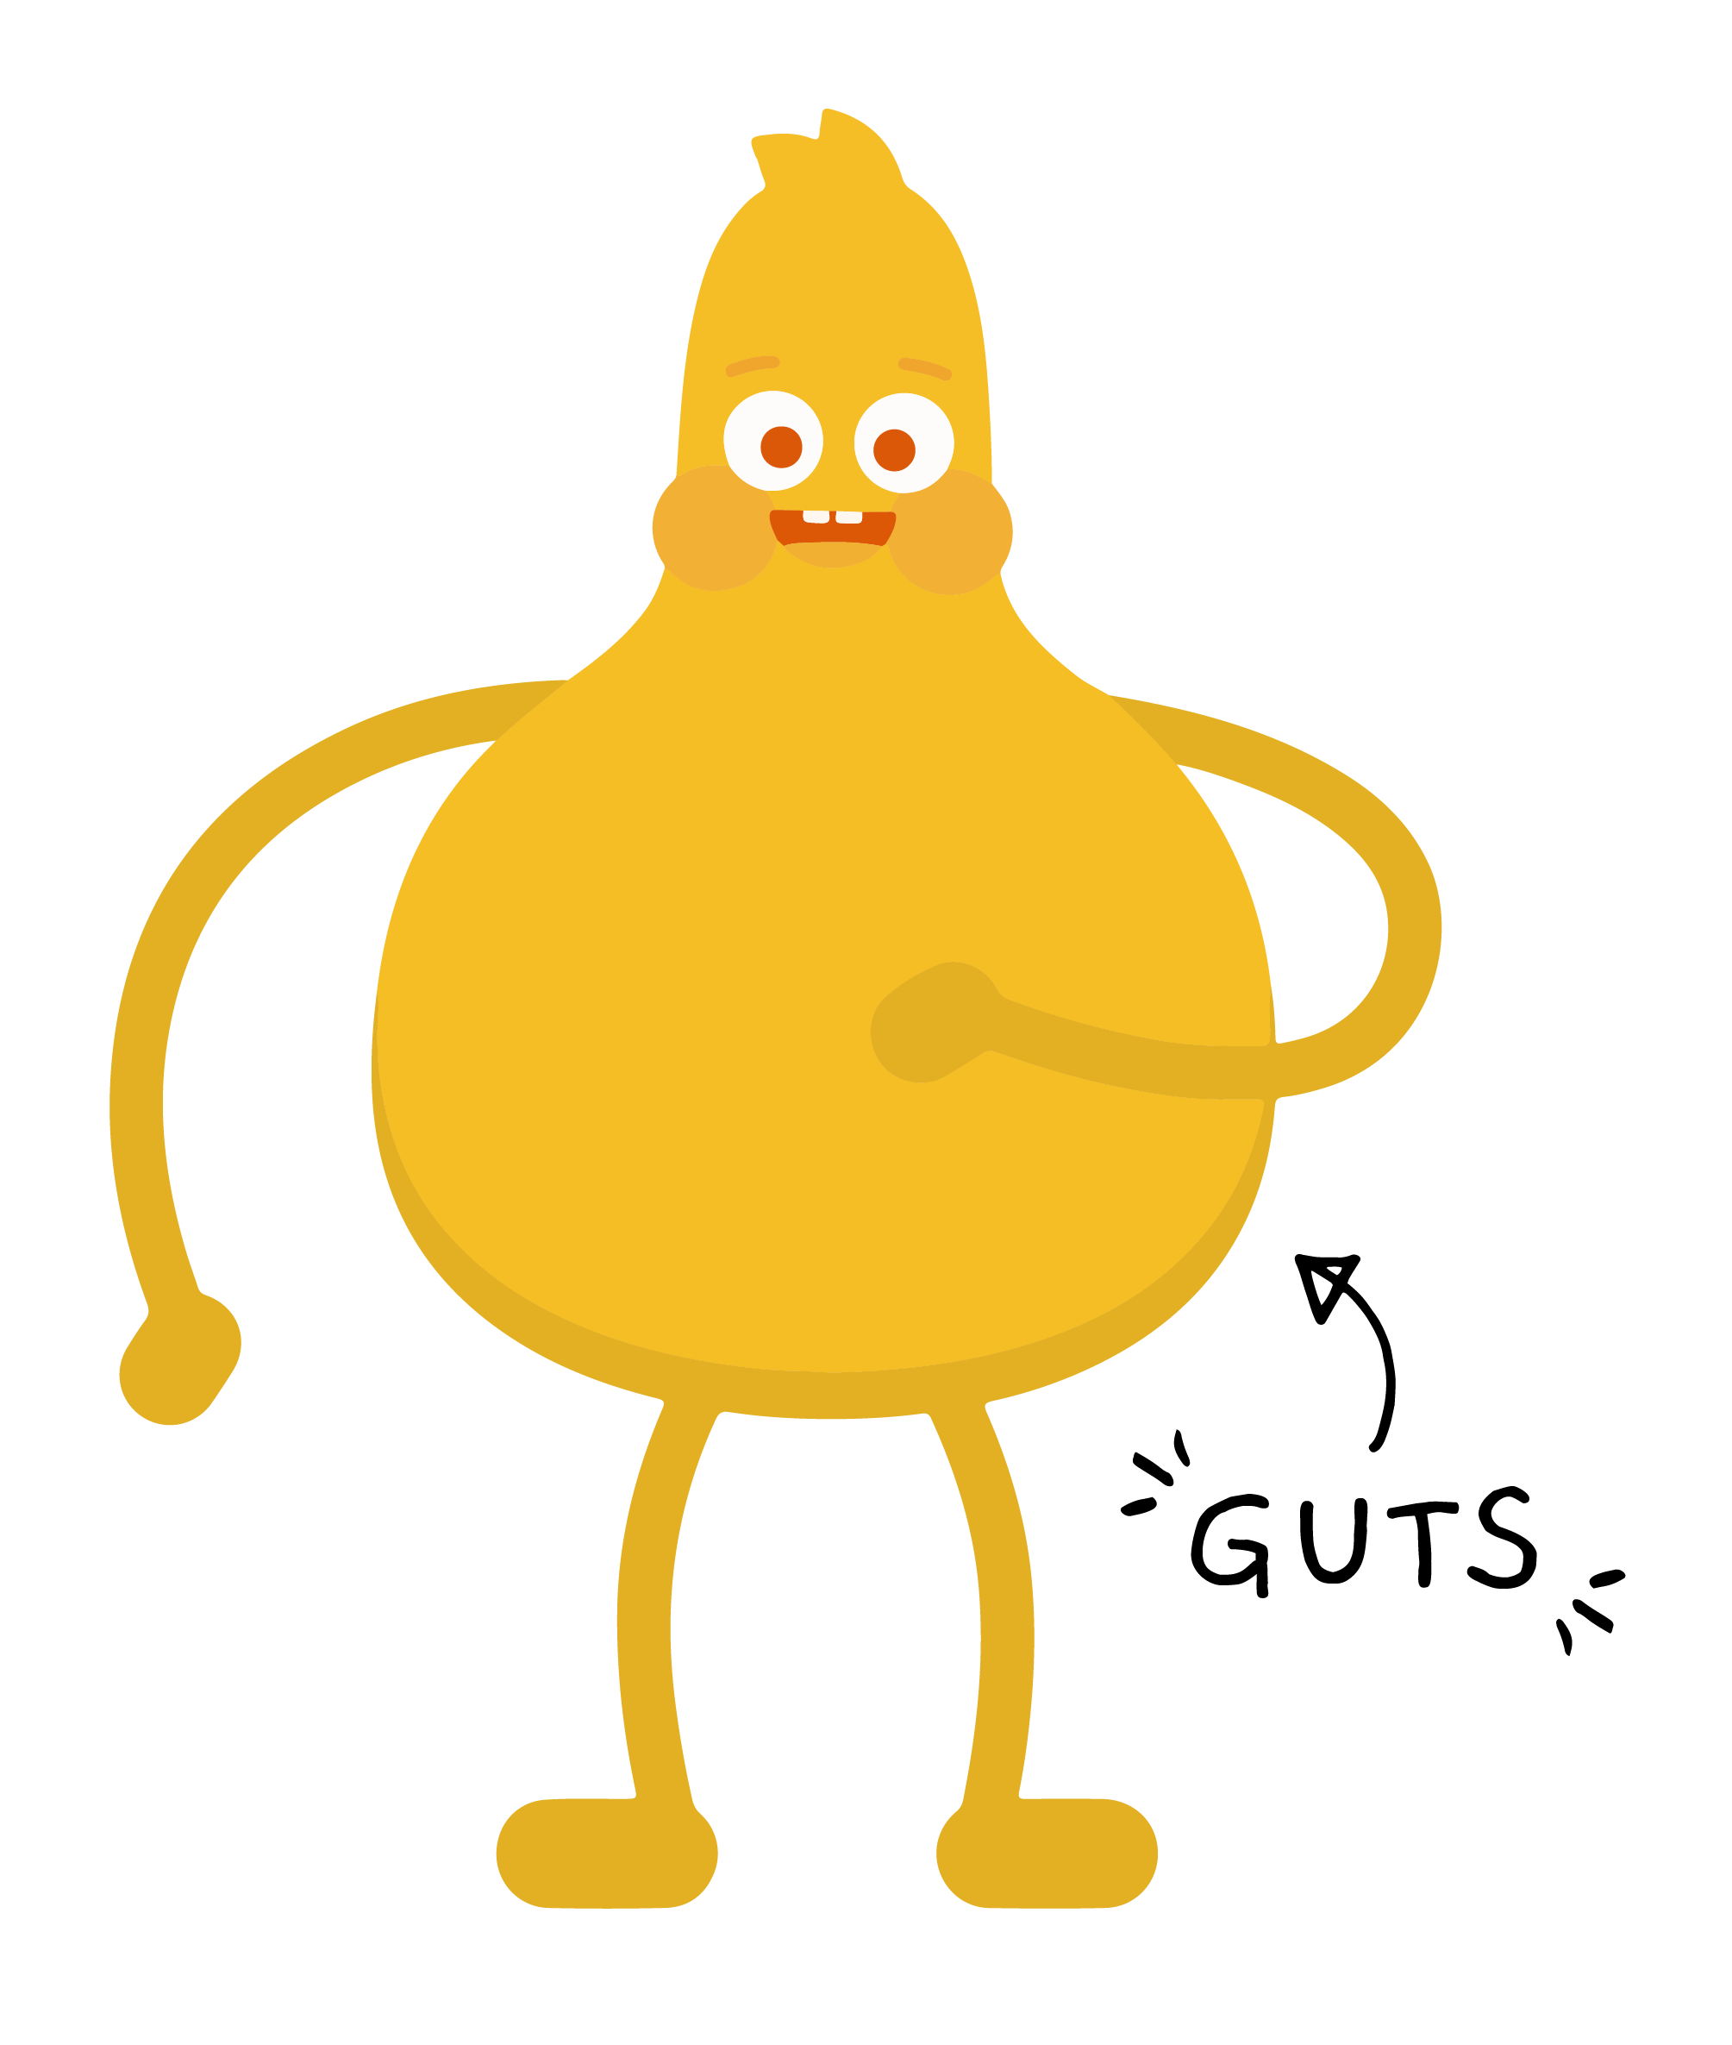
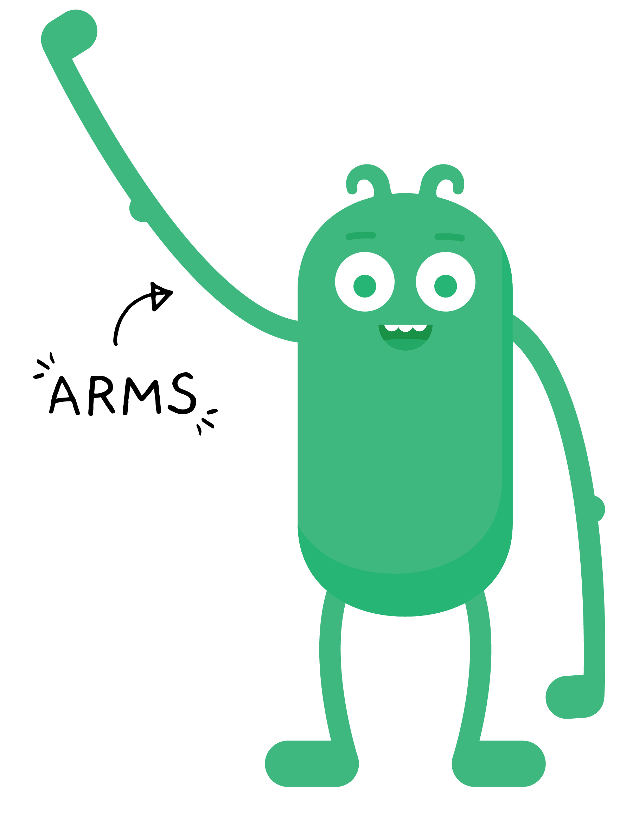
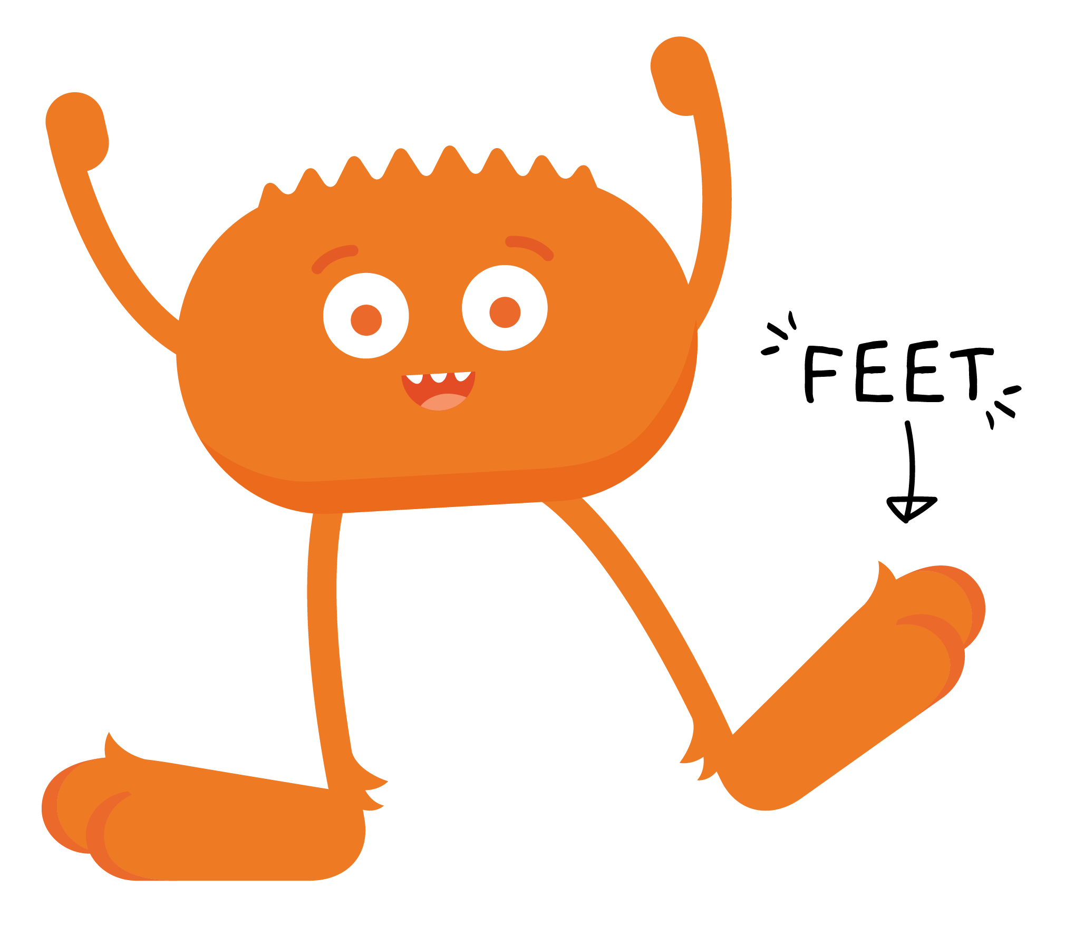
REVIEW

Slide 9
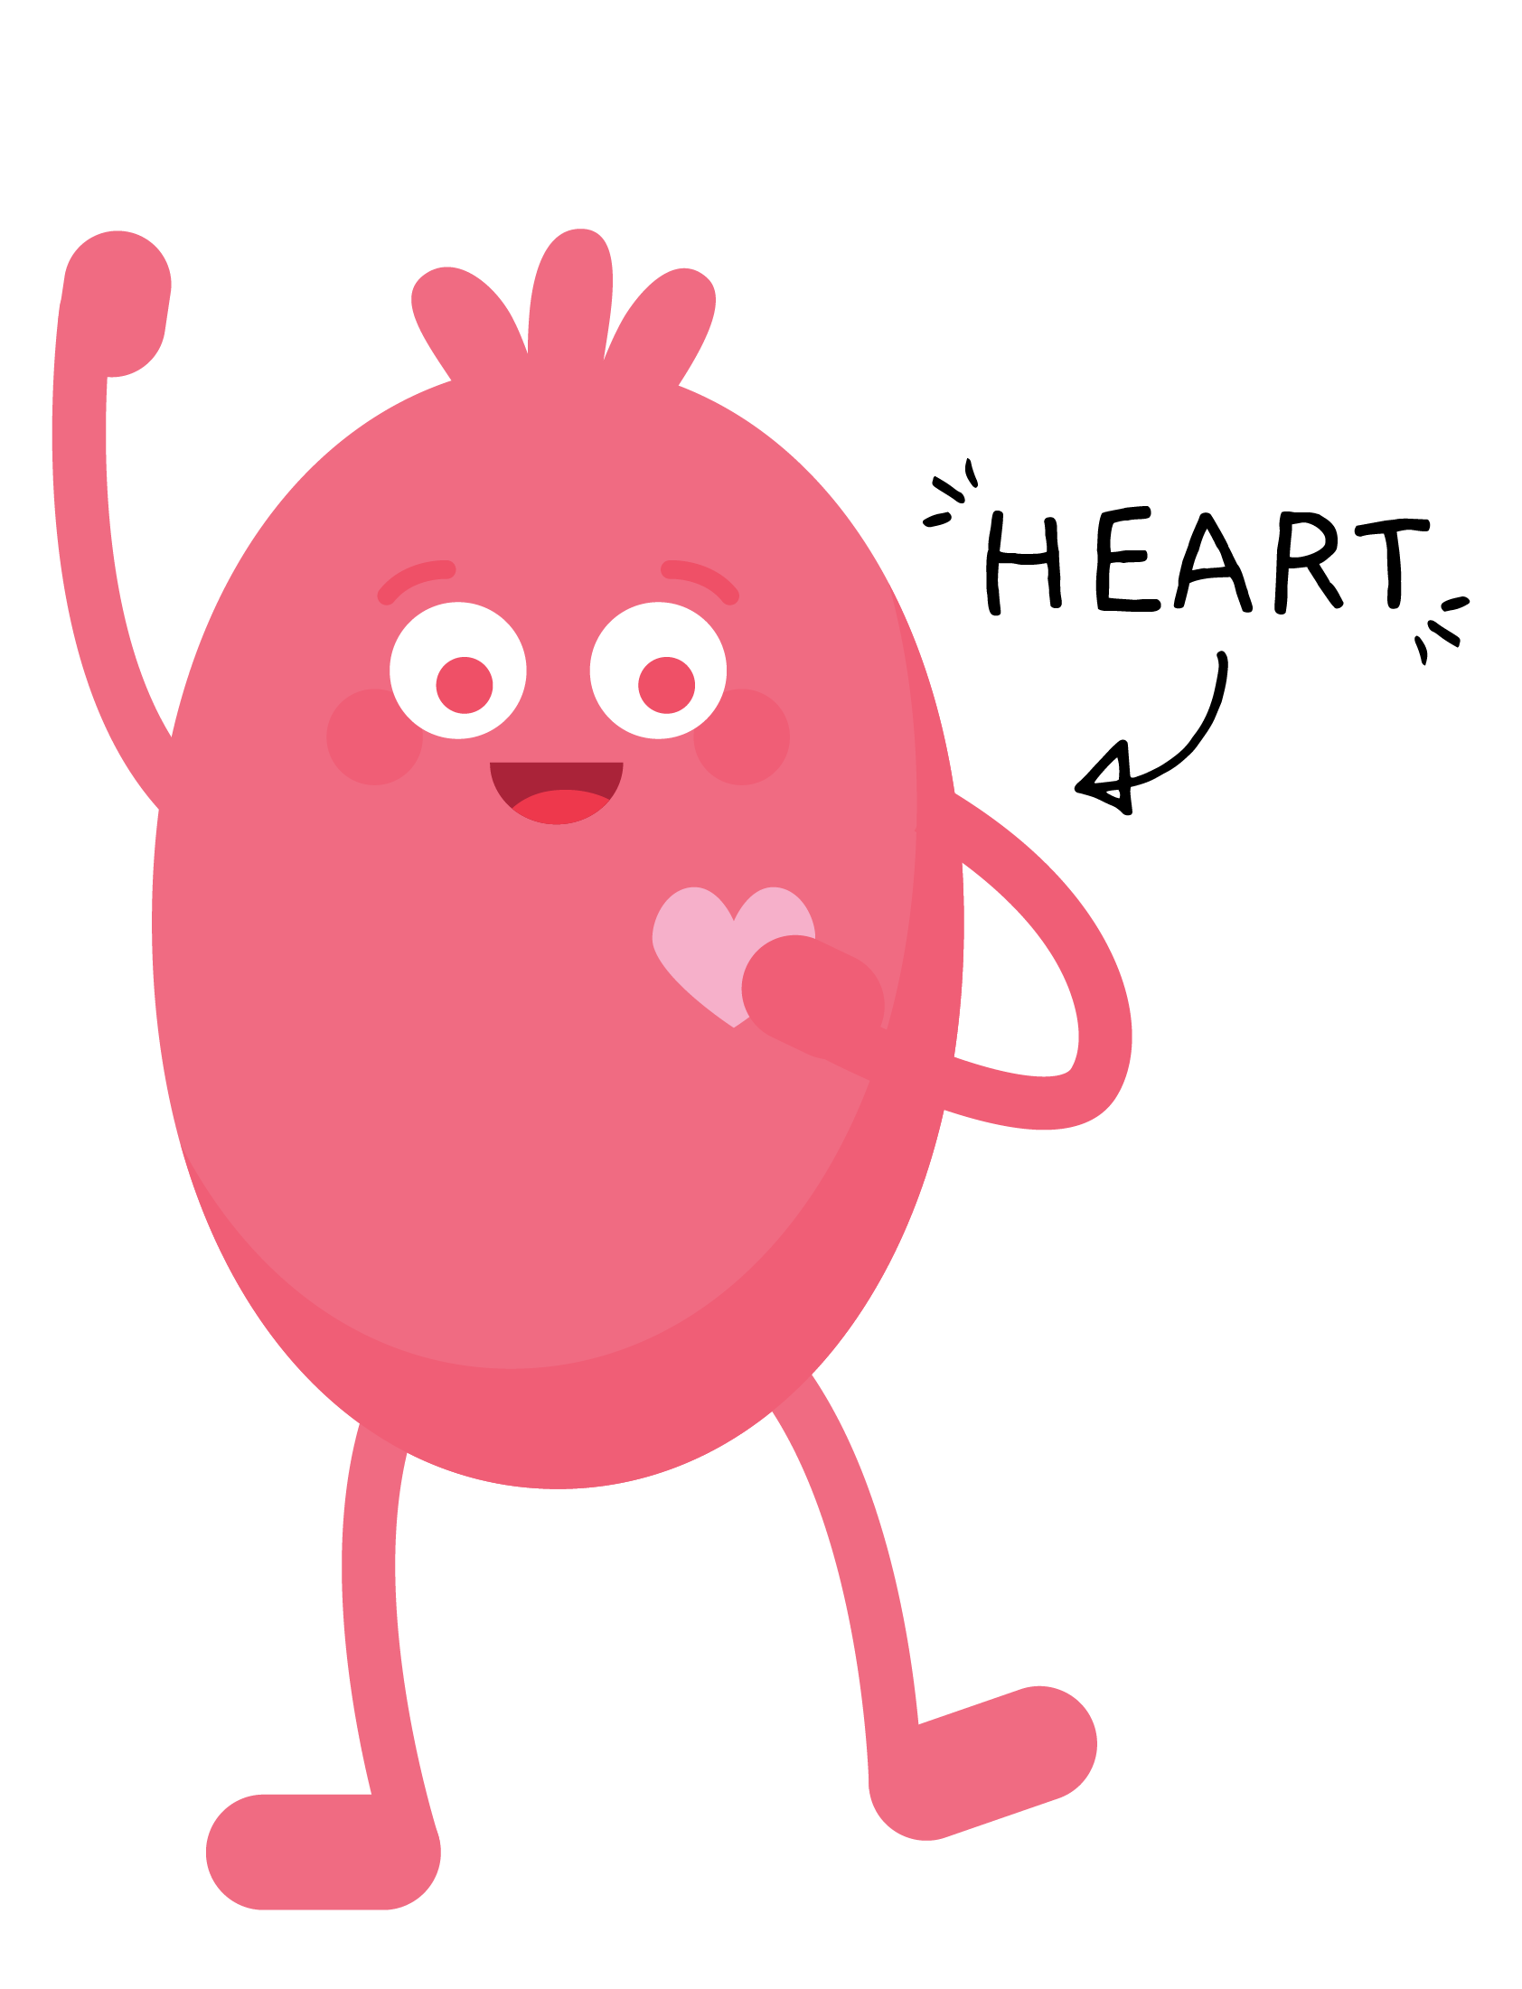
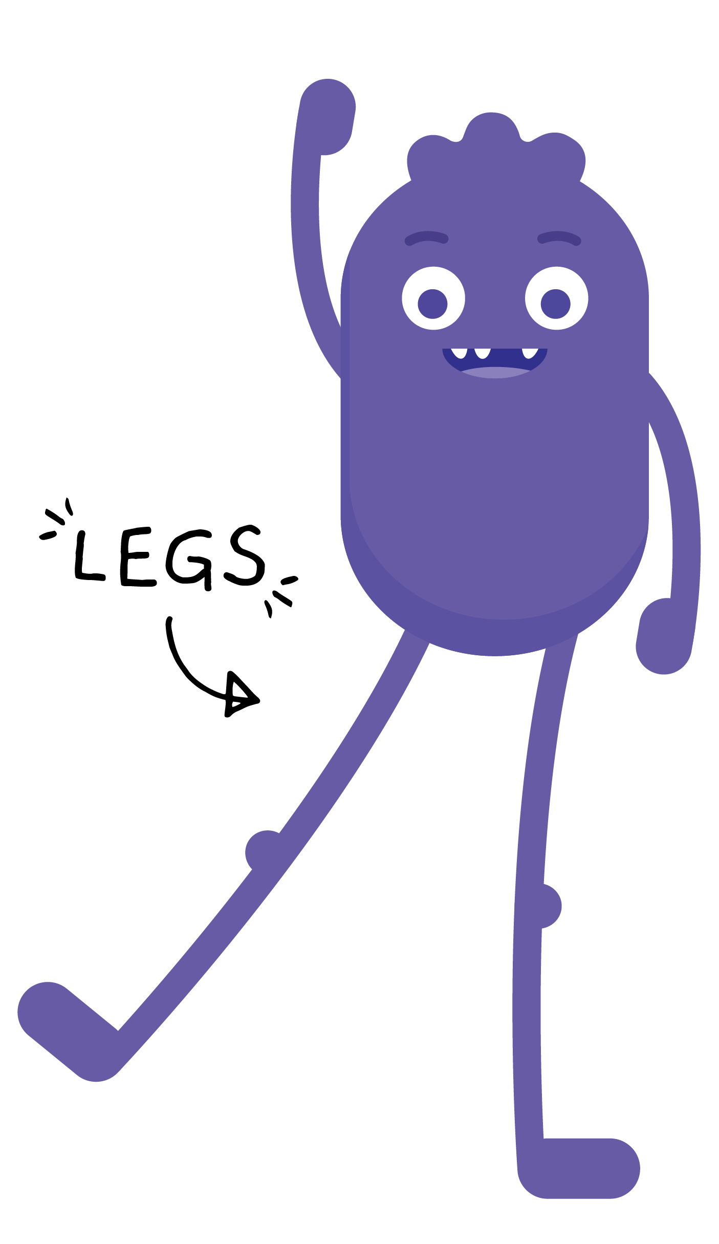
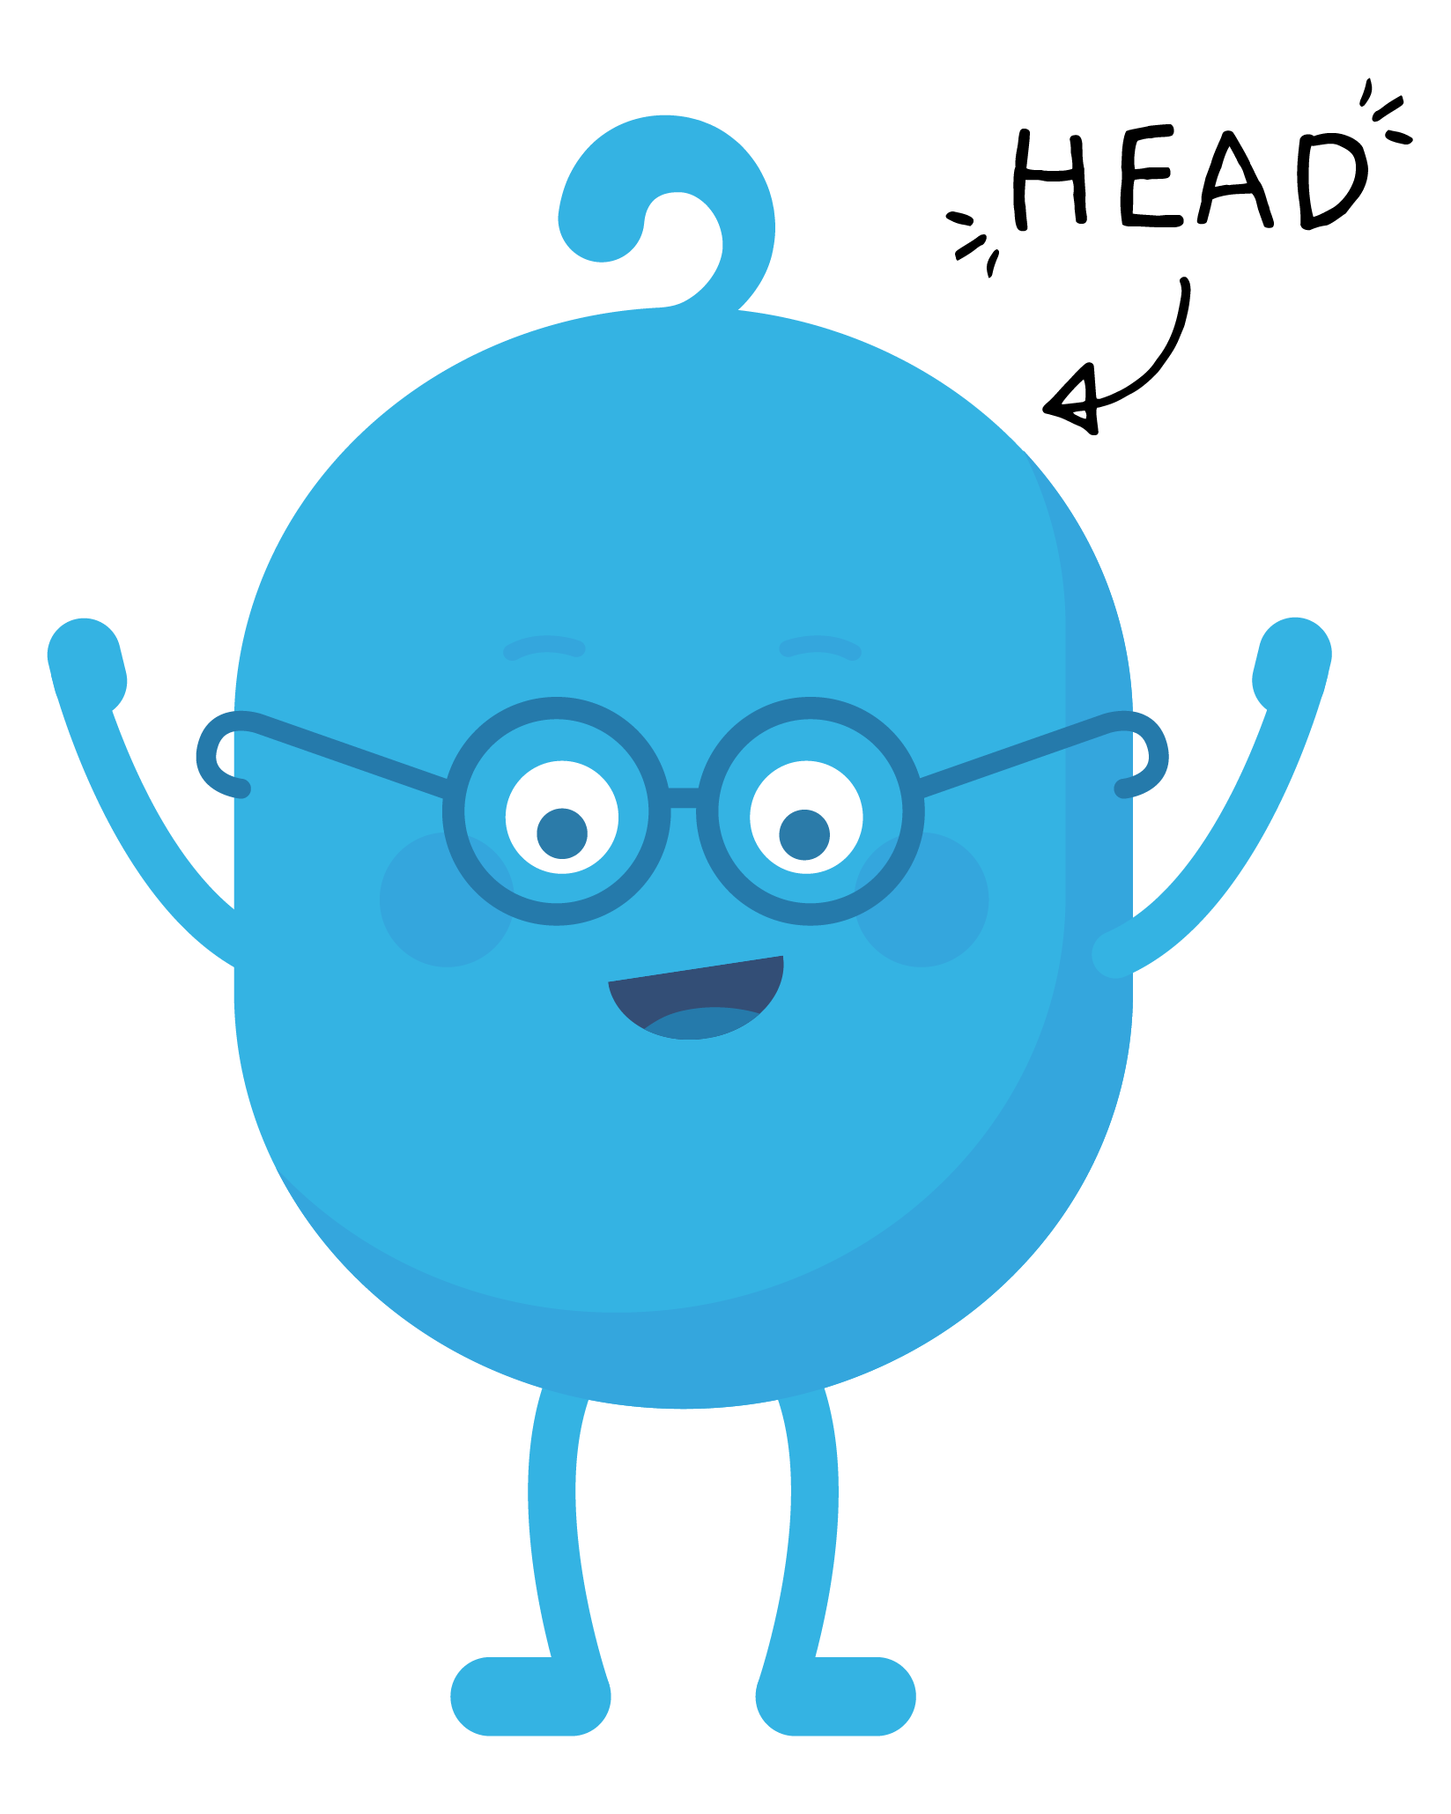
REVIEW

Slide 10
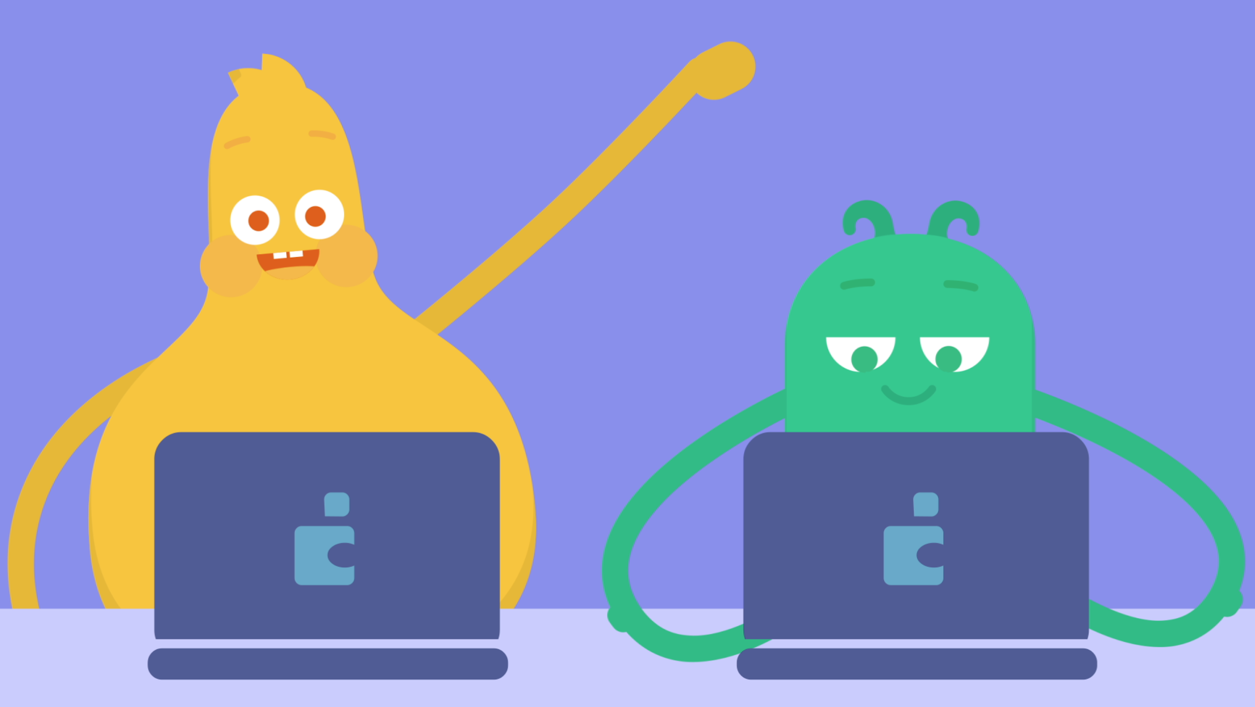
PAIR-SHARE
Why is it important to ask for permission before going online?

Slide 11
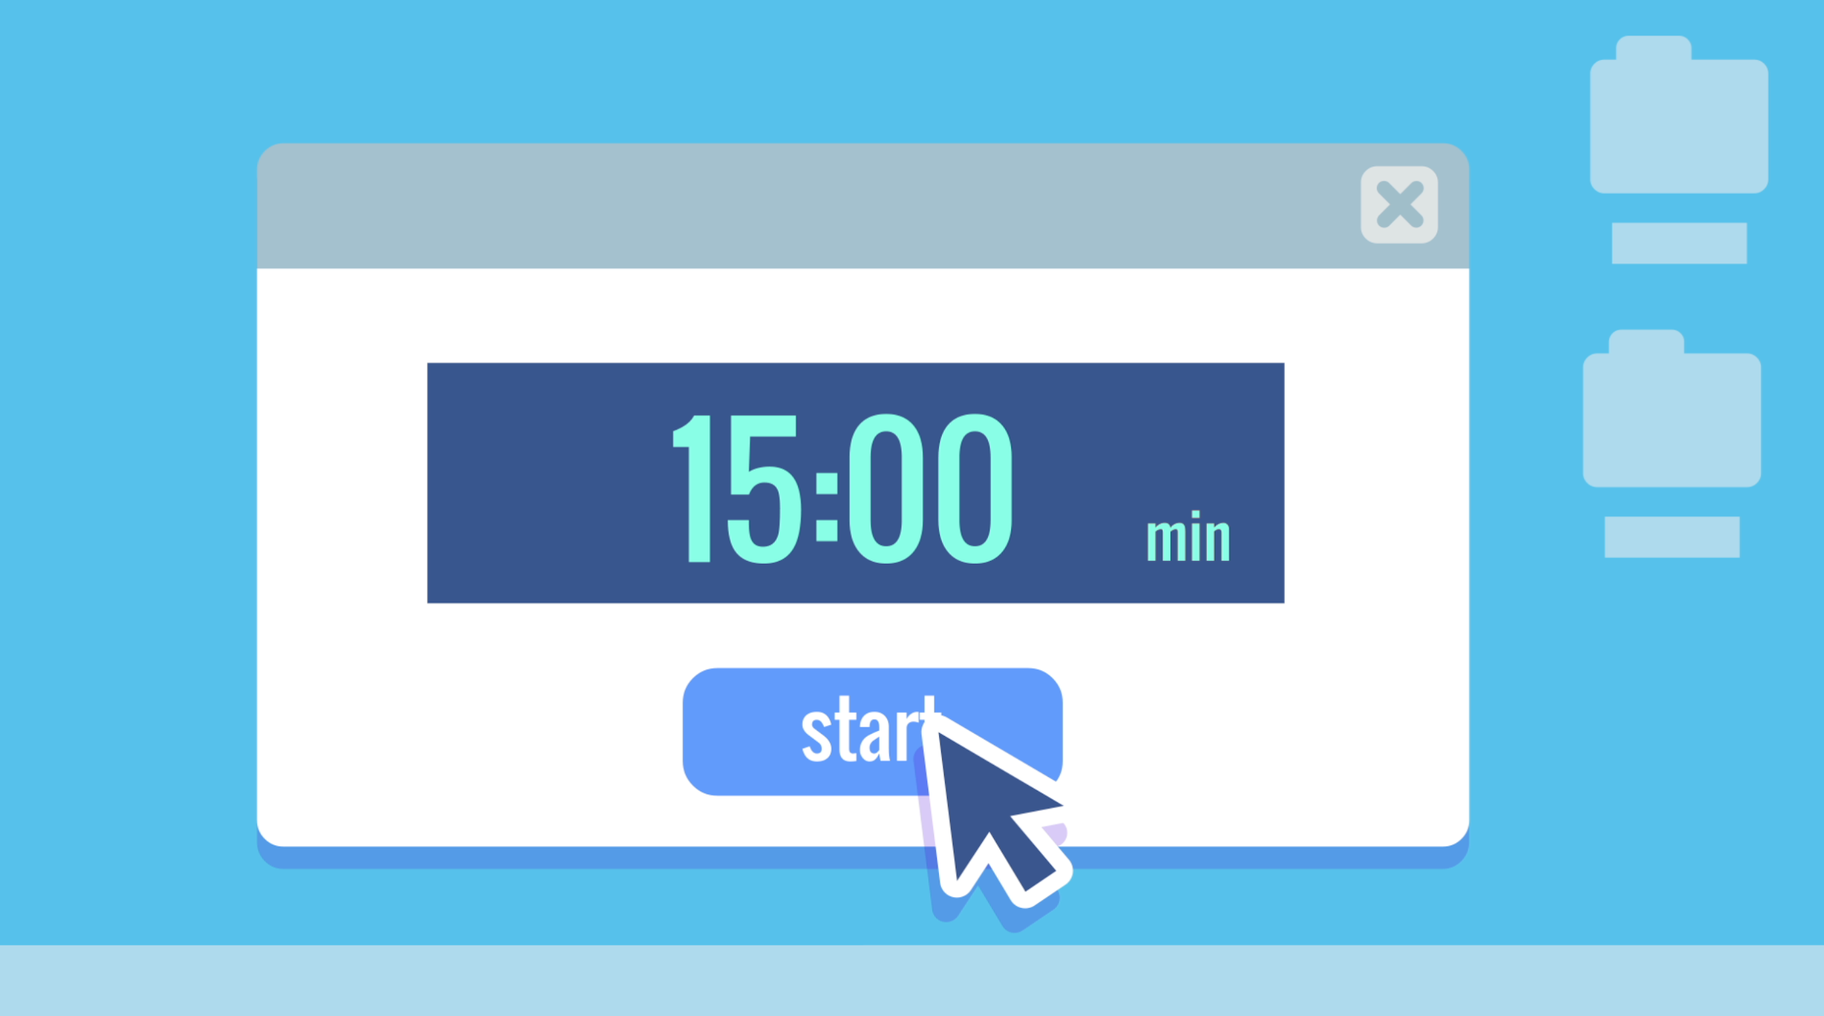
PAIR-SHARE
Why is it a good idea to set a time limit when using technology?

Slide 12
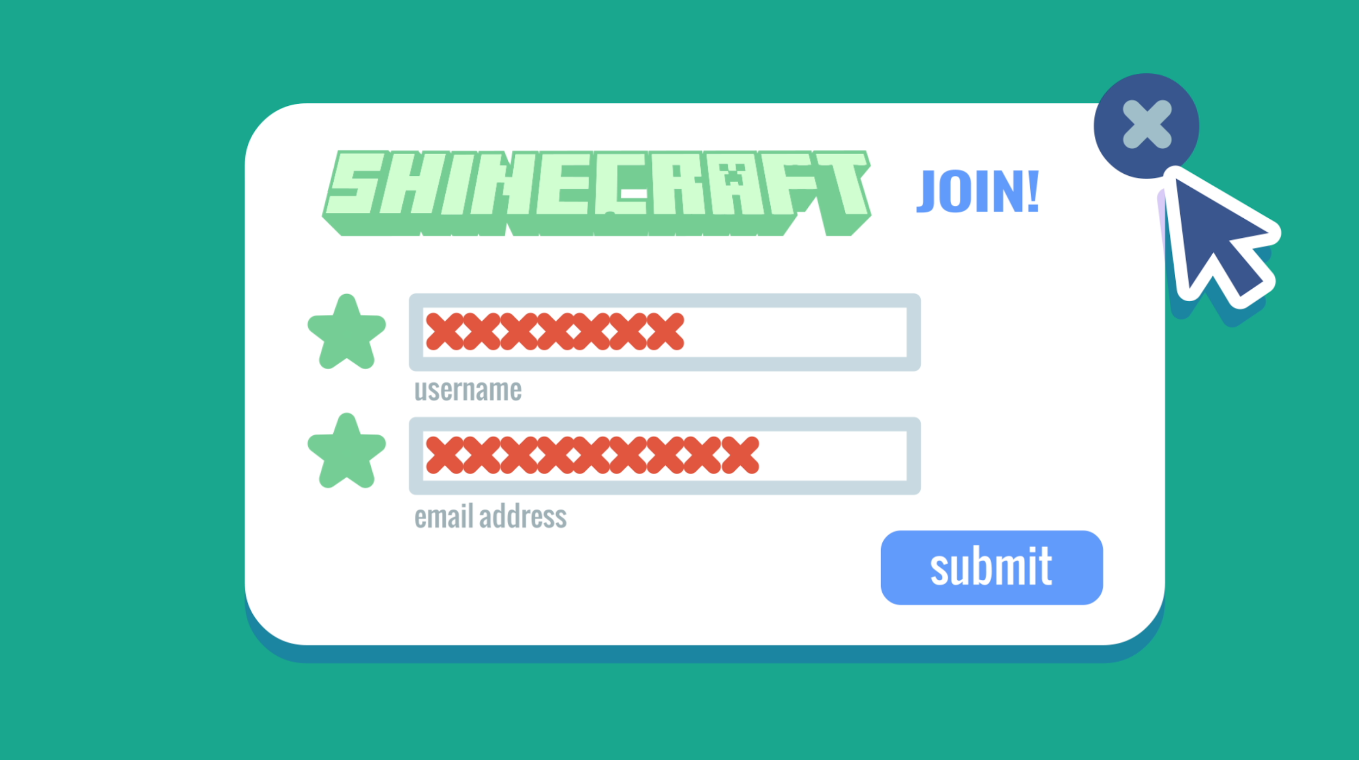
PAIR-SHARE
Why shouldn't you share your username and password with other people?

Slide 13
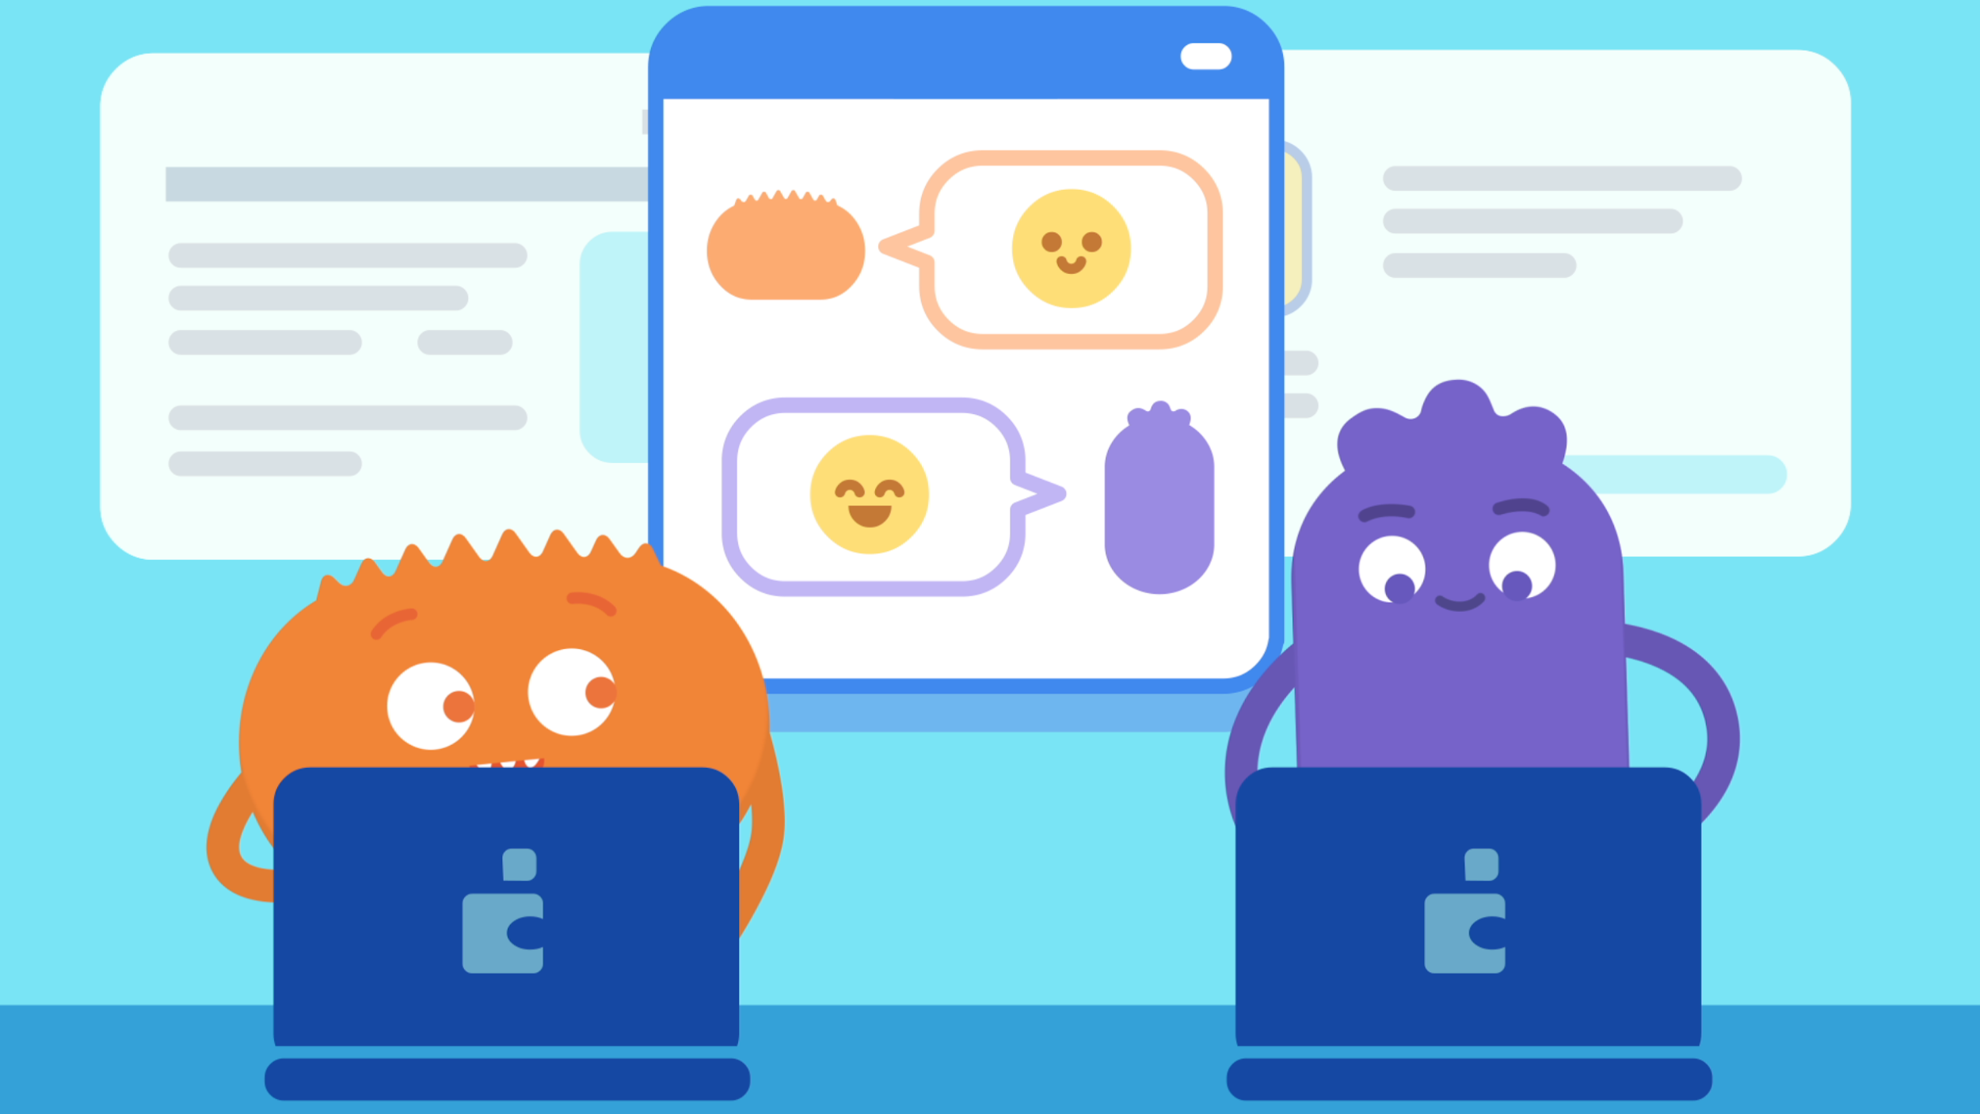
PAIR-SHARE
Why should you only talk to people you know online?

Slide 14
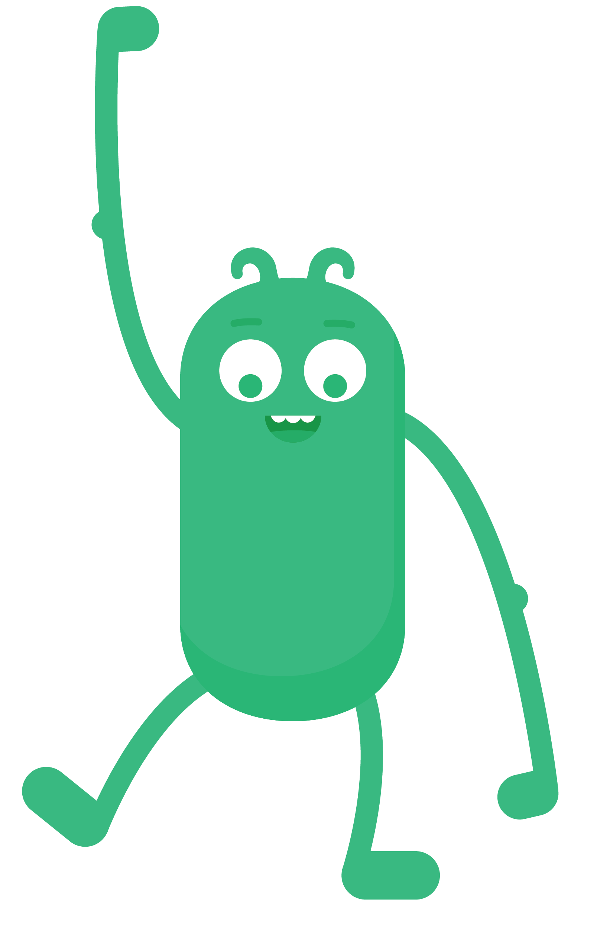
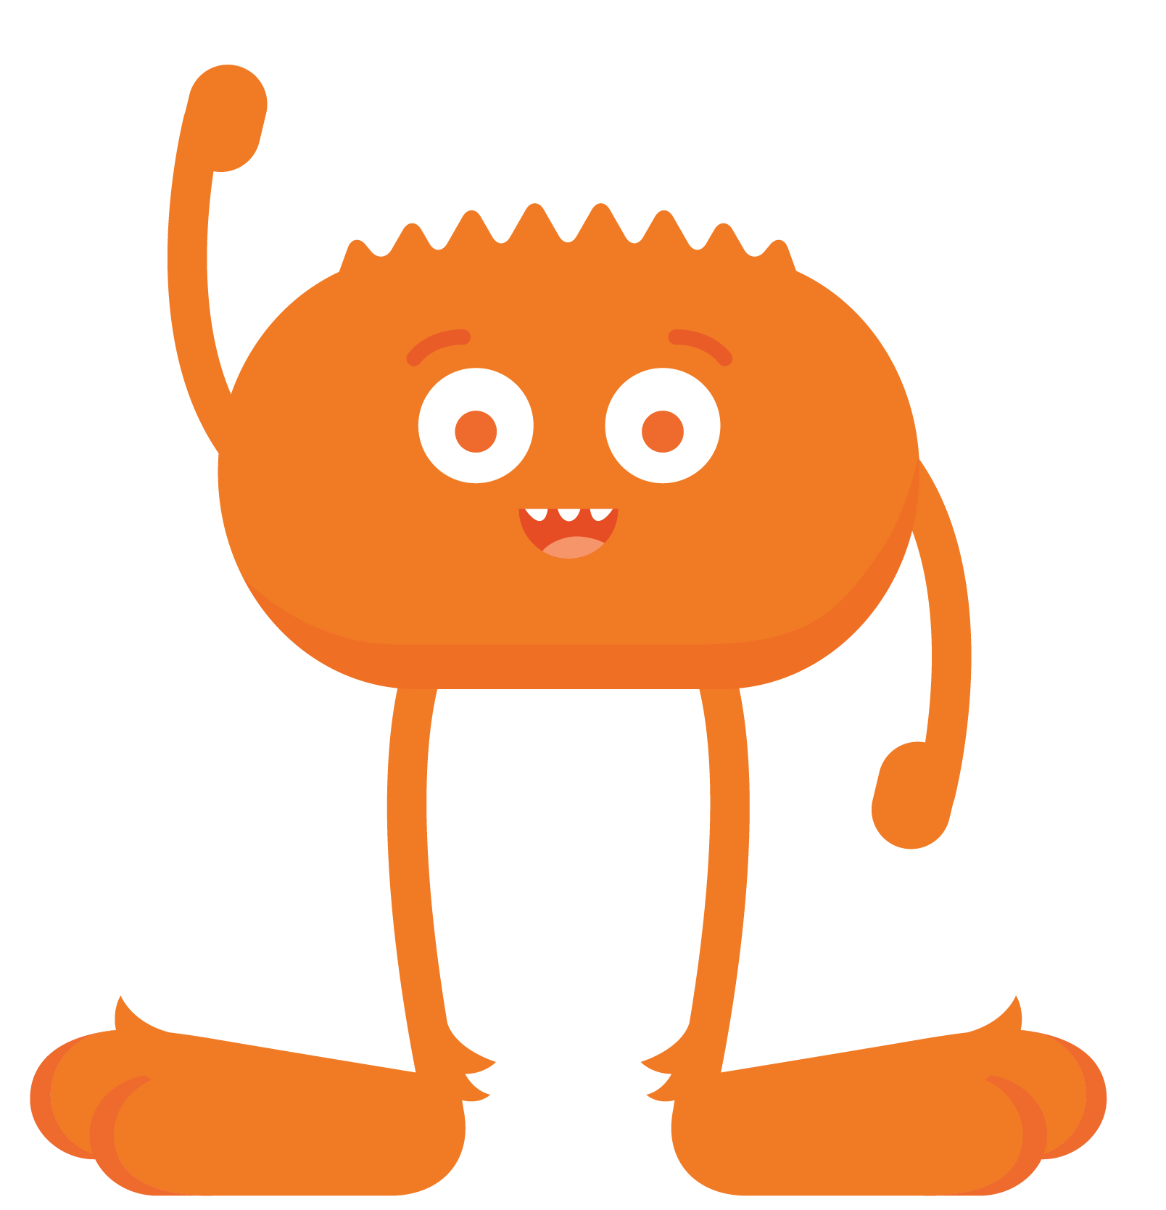
REFLECT HANDOUT
Pause & Think Moment
Draw a picture to show how you will be a good digital citizen.
Write about what you will do to be a good digital citizen.
and

